Slide 1
When life gives you oranges….
Aaron 14/10/2023

Slide 2
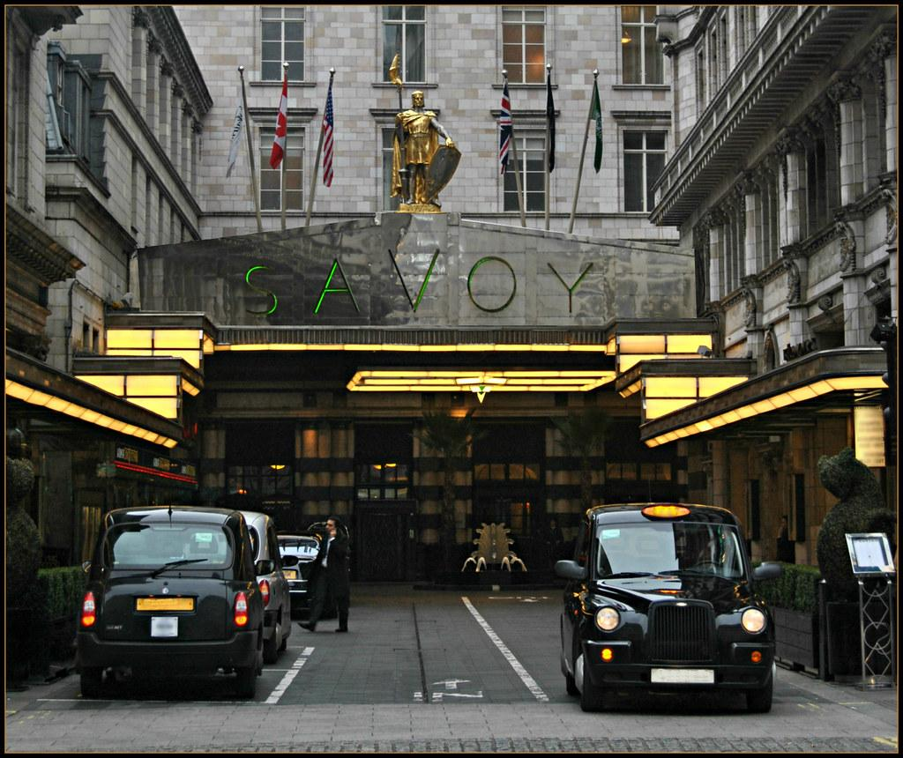
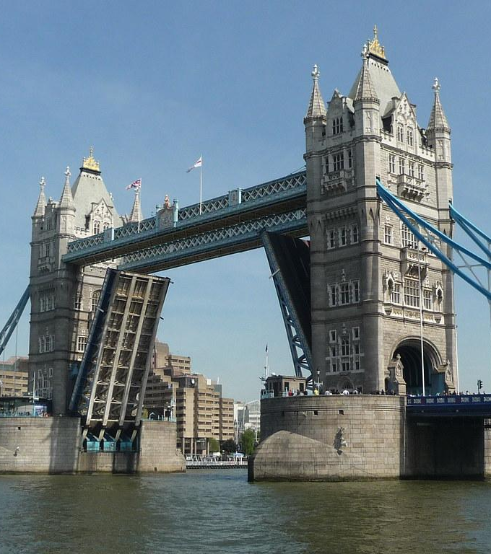
Our story begin in the centre of London.
The Savoy Hotel in the West End.

Slide 3
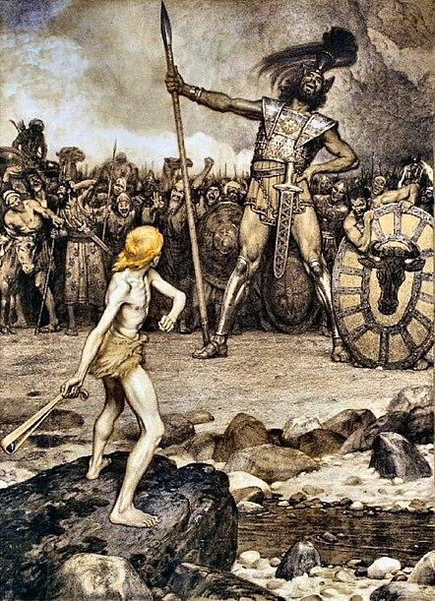
An epic battle between a David & a Goliath.

Slide 4
The heart of the matter was a simple question:
Should freshly squeezed orange juice be classified as "manufactured"?

Slide 5
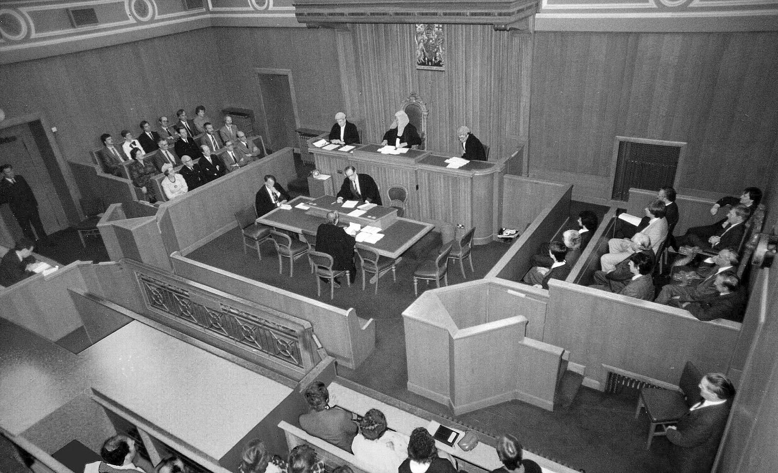
And, therefore, should it be exempt from purchase tax?

Slide 6
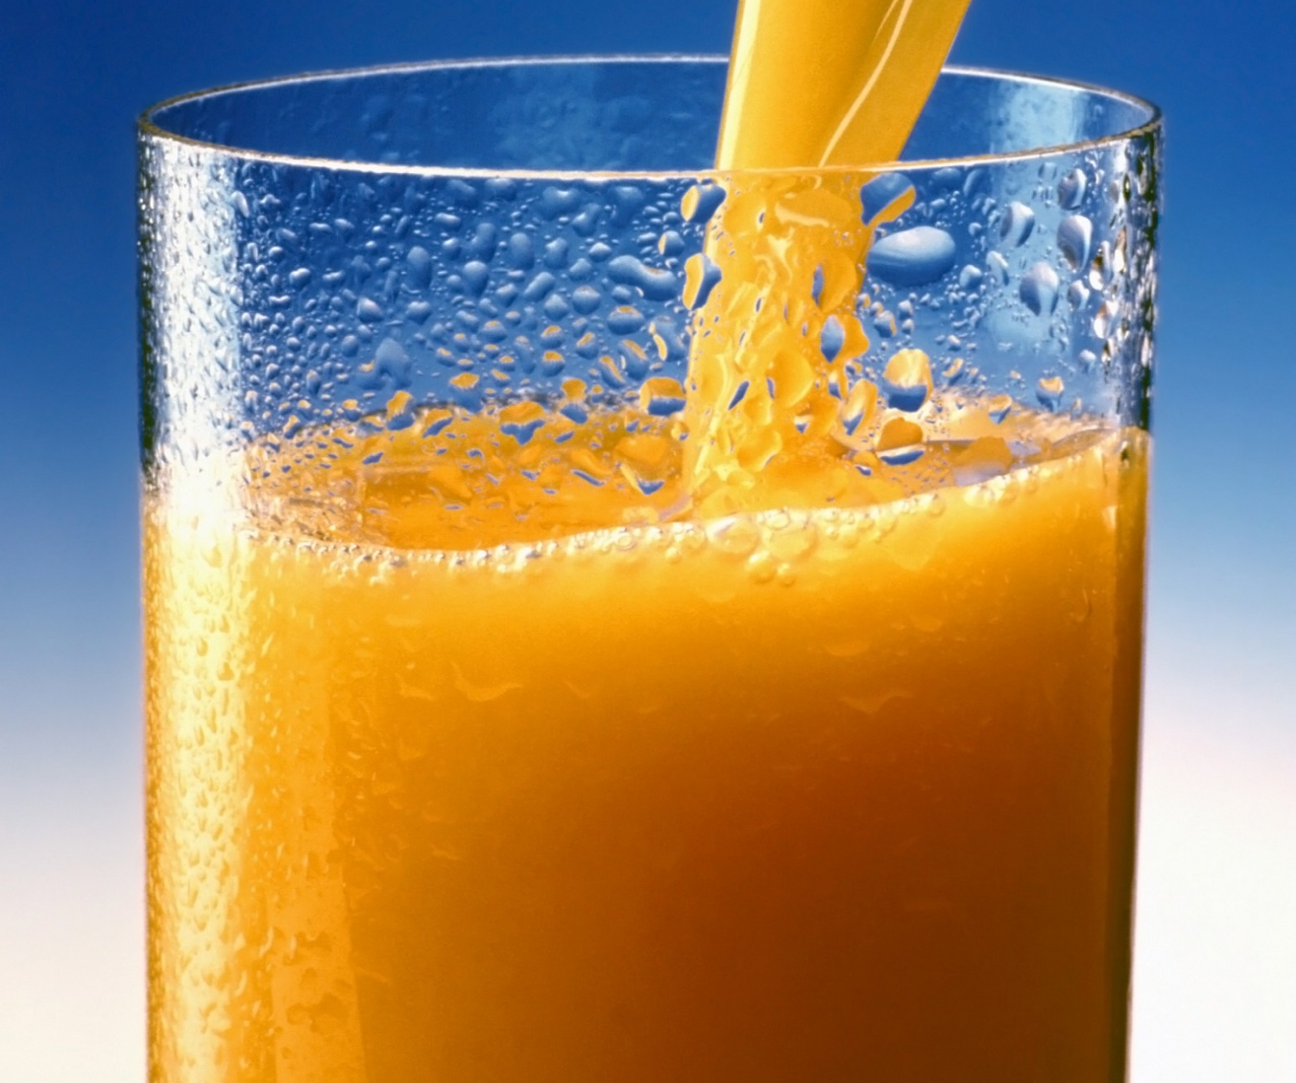

Slide 7
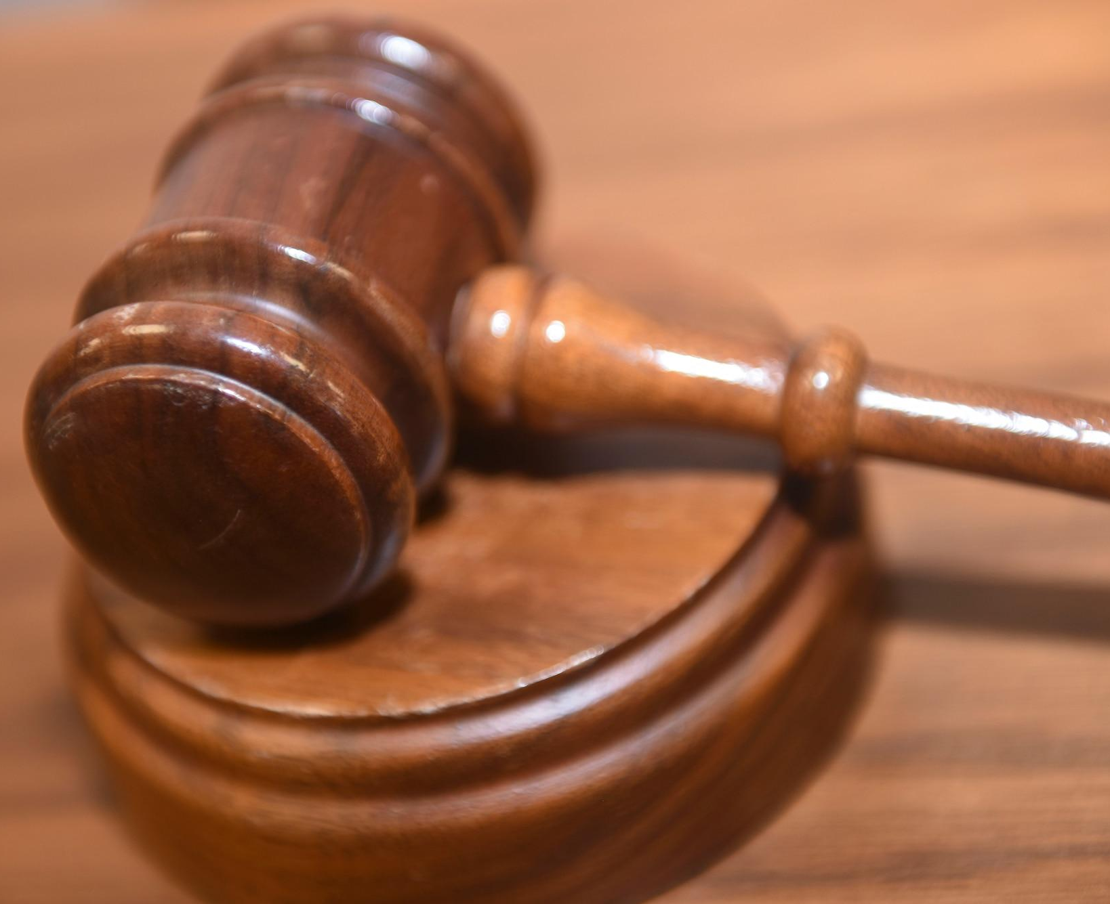
David Won

Slide 8
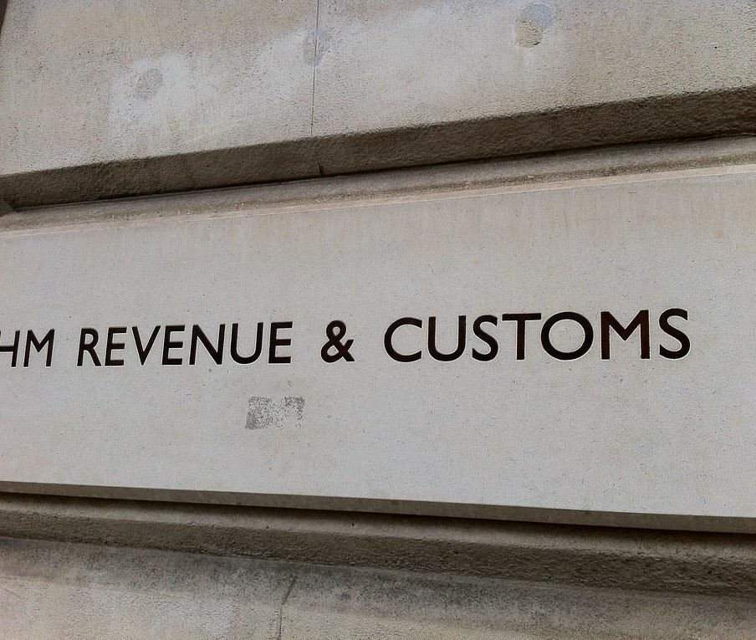

Slide 9
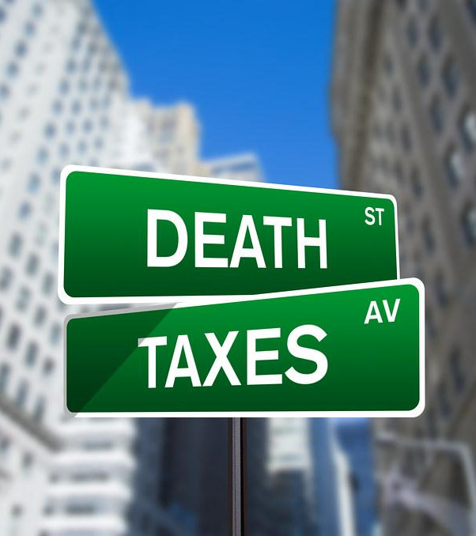

Slide 10
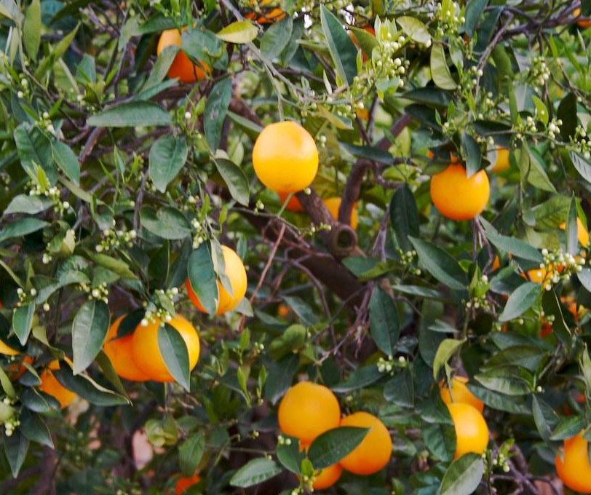
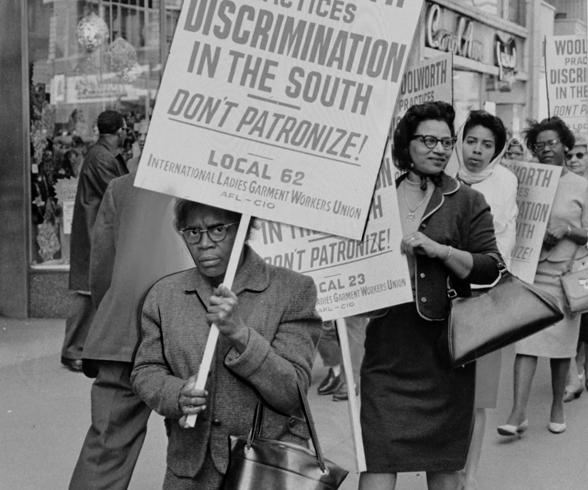
At the time, the fresh juice industry was a billion-pound behemoth, and the decision to tax it went unchallenged. Even though front bench politicians argued that the new tax would cost up to 1,850 jobs, the decision stood.

Slide 11
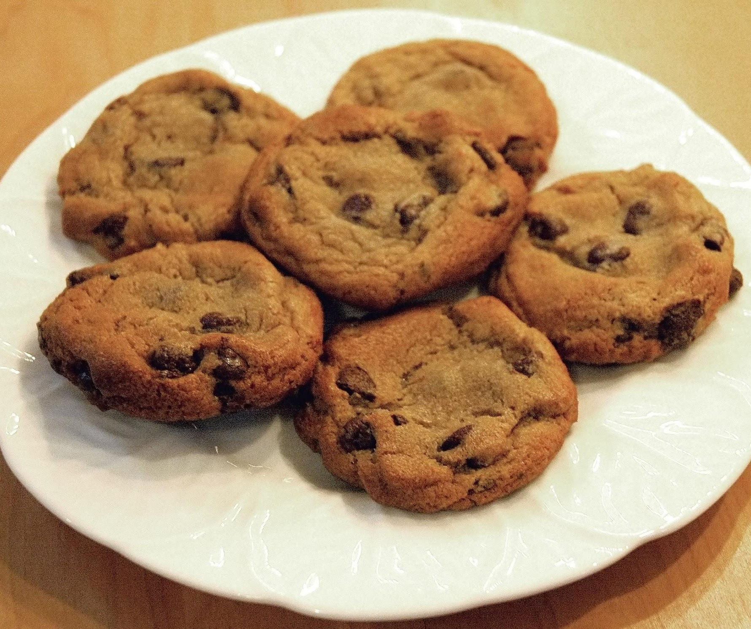
VAT at 20%
At the time, the fresh juice industry was a billion-pound behemoth, and the decision to tax it went unchallenged. Even though front bench politicians argued that the new tax would cost up to 1,850 jobs, the decision stood.

Slide 12
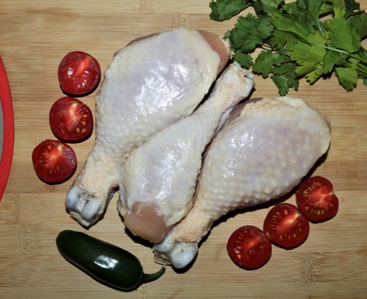
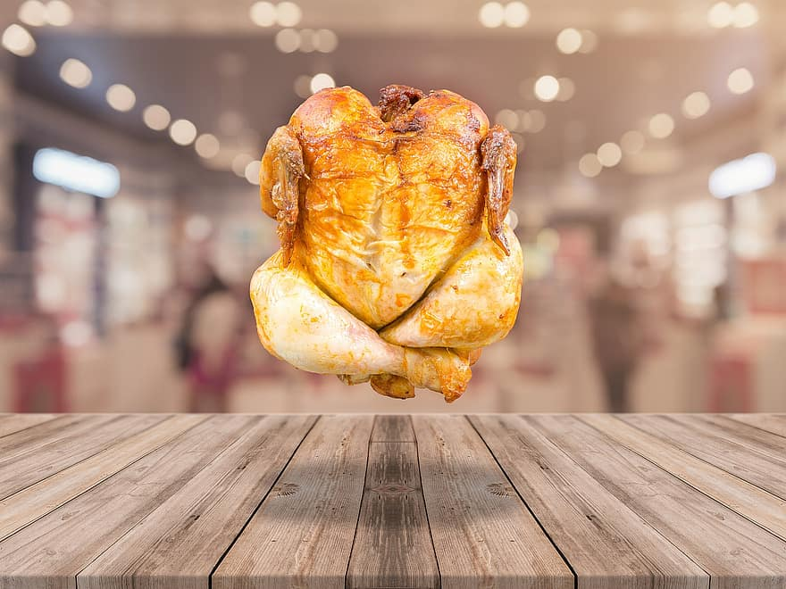
VAT or No VAT?
By a show of hands

Slide 13
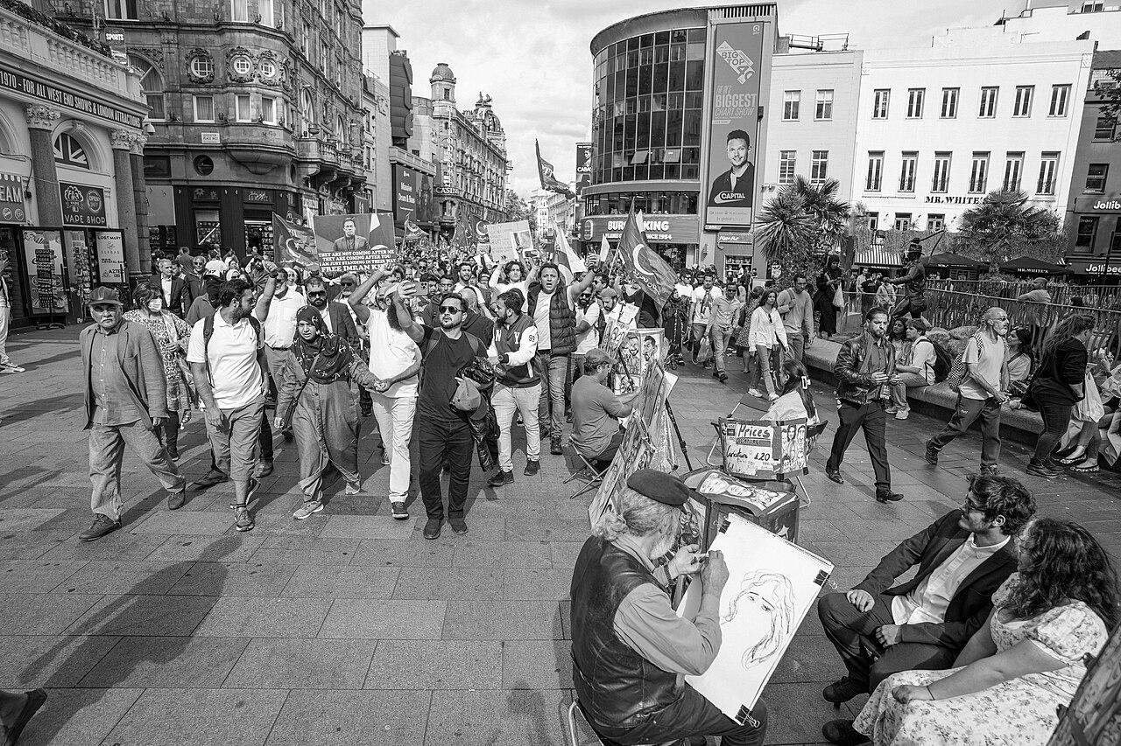
The clock is ticking, and the implications are clear. If we fail to take a stand and challenge these arbitrary regulations, the very industry we hold dear might cease to exist by 2030.
The time to act is now.

